Slide 1


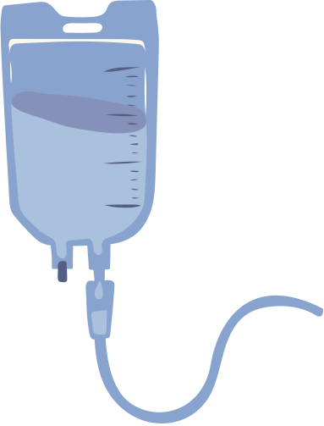



SparkSink
Senior citizen help alert to nearest nurse
During emergencies, senior citizens frequently encounter delays in receiving timely medical assistance. This project aims to develop a system that locates the nearest nurse and notifies them promptly, ensuring quicker response times for vulnerable patients.

Slide 2
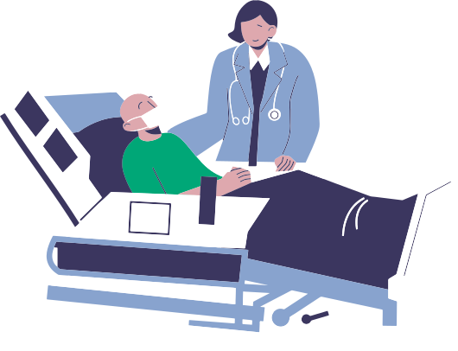
Solution
Identifying the nearest nurse for a patient in need
Tracking live locations of patients and on-duty nurses
Utilizing GPS, it will pinpoint the real-time locations of both patients and nurses, enabling the identification of the nearest available nurse based on geographical proximity.
Real-Time Traffic-Informed Pathfinding (RRT)
Implementing a system that allows nurses to log in and share their current location, which can be updated automatically as they move.
Determining the Fastest Route for the Nurse to Reach the Patient
Broadcasting the User Request
Determining shortest route by utilizing real-time mapping services that analyze current traffic conditions and optimal pathways
Instead of sending the emergency request to just one nurse, by broadcasting emergency requests in radial manner, we ensure rapid response times and efficient care delivery.

Slide 3

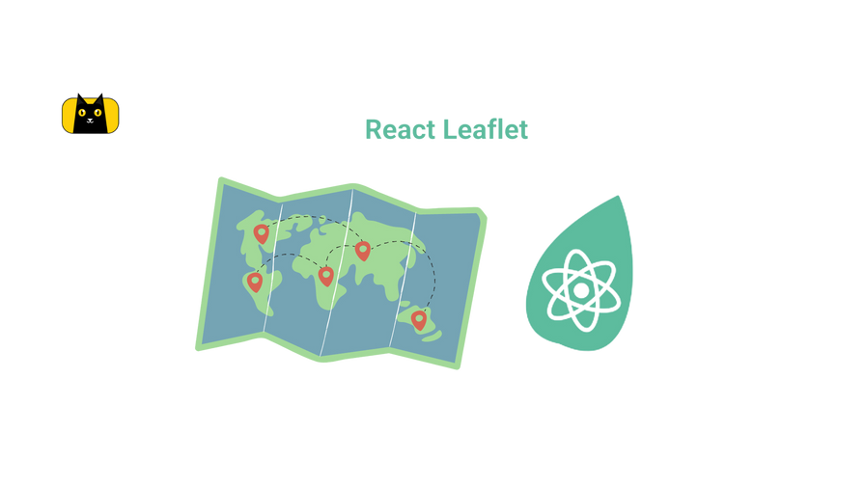











Tech Stack & Architecture
patient and nurse location
React Leaflet
Continuously notifying the nearest nurse
Emergency
emergency alert
send notification to nurse
Patient
Backend
Patient triggering an emergency alert
Nurse
Dashboard

Slide 4
